Slide 1
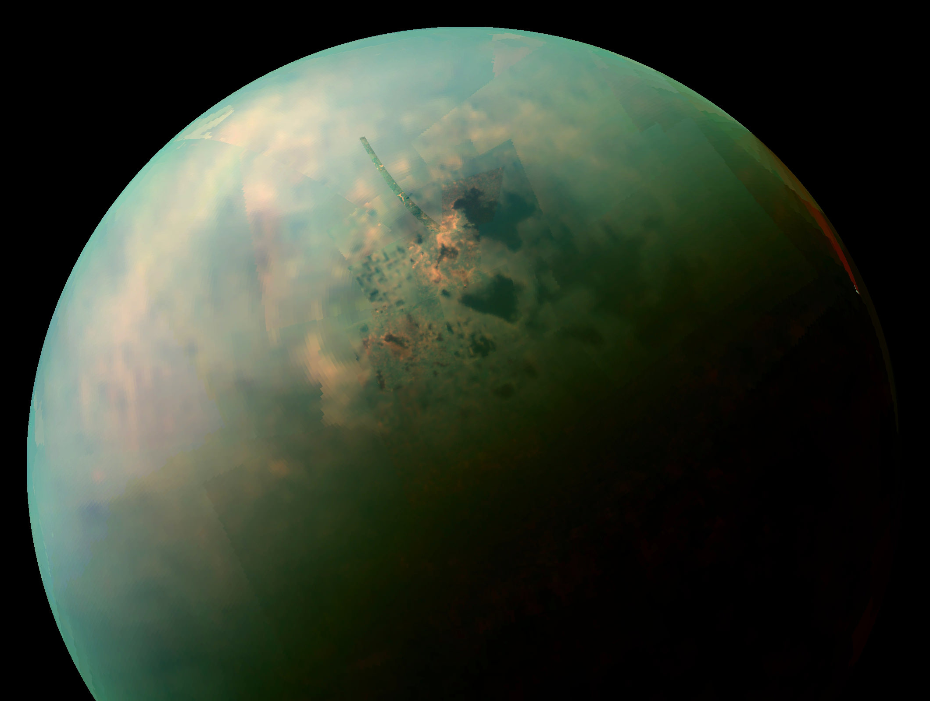
Project 2.1 – Group 11
Probe launching to Titan
Laura Jogi, Laura Vila Gonzalo, Roy Legziel, Matthew Goncalves Da Silva ,Luc Meels, Jan Socha

Slide 2
Solar system model - components
Celestial bodies - Sun, Mercury, Venus, Earth, Mars, Jupiter, Saturn, Uran, Neptun, Titan
Physics engine - gravitational force, acceleration and velocity updates

Slide 3
Celestial Body
Each celestial body (and probe) has the following features:
Mass
Radius
Location (X, Y and Z coordinates)
Velocity ( as a composition of velocities X, Y and Z)

Slide 4
Physics engine
The Solar System is initialized and after each time step t (e.g. 1hour) all its parameters and graphics are updated.
Time t
Solar System initialization
Computing and adding all the force components for each body using the law of universal gravitation.
Computing the acceleration for each body according to the second Newton’s law.
Computing the new velocity for each body after time t.
Computing the average velocity of each body during the time step and updating its locaton.
Physics engine cycle

Slide 5
Solar system model - features
Cartesian coordinate system with Sun as its origin
3D location computations and 2D graphical interface
The model launches on <day> (NASA provides coordiantes for each body)
Physics simplification – only gravitational forces are simulated.
After each time step (e.g. 1hour) all the parameters are computed and updated in the following order: gravitational forces, acceleration, velocity and location

Slide 6
Probe trajectory
”Linear” trajectories (no gravity assist).
The launch velocity is <velocity>.
Trial and error method (changing parameters by marginal values)

Slide 7
Phase 2 - plans

